Slide 1

Team Members:
Jairo Arreola (jaa0019@uah.edu)
Daniel Burris (dab0021@uah.edu)
Komlan Maglo (kmm0048@uah.edu)
Adam Walters (atw0015@uah.edu)
CPE 495-01 Computer Engineering Design I
Electrical and Computer Engineering
The University of Alabama-Huntsville

Slide 2
Project Summary
The UAH Navigational Application will give users the luxury of having a refinement of the Google Maps API that will lead users to their desired location within the UAH Campus. This concept can be expanded to work with additional buildings that are not inside of the UAH Campus. This project is also an opportunity for new students and visitors to get quickly used to UAH campus map, or even current students or alumni in case of new buildings or changes in campus map. The Application will allow users to search for their destination by typing in the Class ID, Room Number, or Building ID, and will lead the user to the room. The navigation will be primarily GPS-based. If the GPS loses signal while inside a building, the App will offer an alternative turn-by-turn text-based solution. This Application will focus on development for Android-compatible devices. If the user types in a Class ID, the application will also display information about the class like the time and day it is offered, information about the instructor pulled from the UAH website, and the Room Number associated with the class.

Slide 3


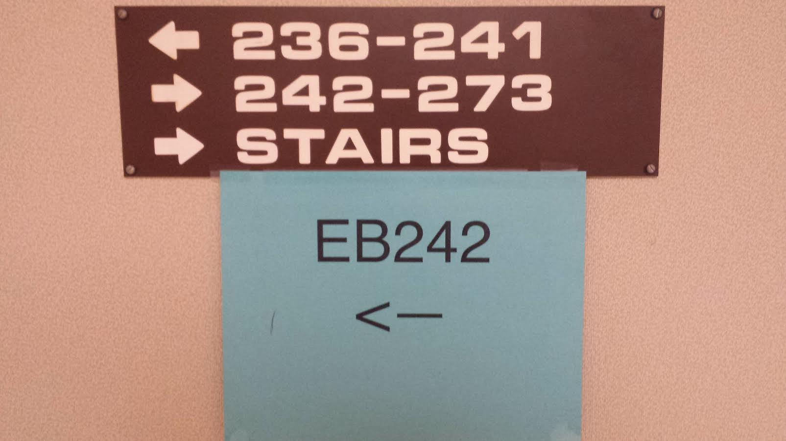
The Need for this Project
Scenario 1
Scenario 2

Slide 4
Executive Board
Adam Walters—Project Lead, CEO
Jairo Arreola—Server Administrator, Fall Intern
Daniel Burris—Database Manager, GM
Komlan Maglo—Interface Programmer, President

Slide 5
Individual Responsibility
Project Lead—Ability to observe the overall scope of the project, including scheduling, development, and testing management.
Server Admin—Develops server and designs code to handle location requests.
Database Manager—Creates entries for each Classroom, Building, and Class for the Navigation App to use.
Interface Programmer—Designs the GUI for the App.

Slide 6
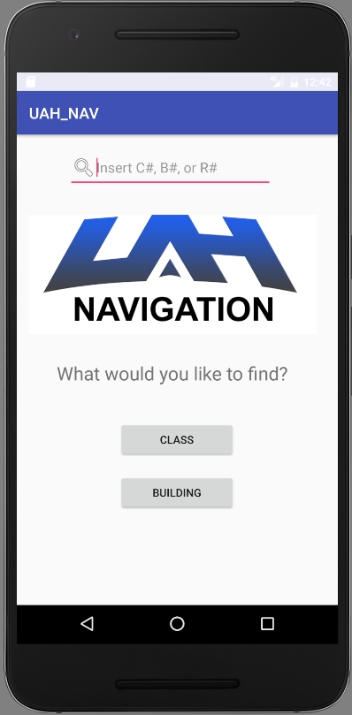
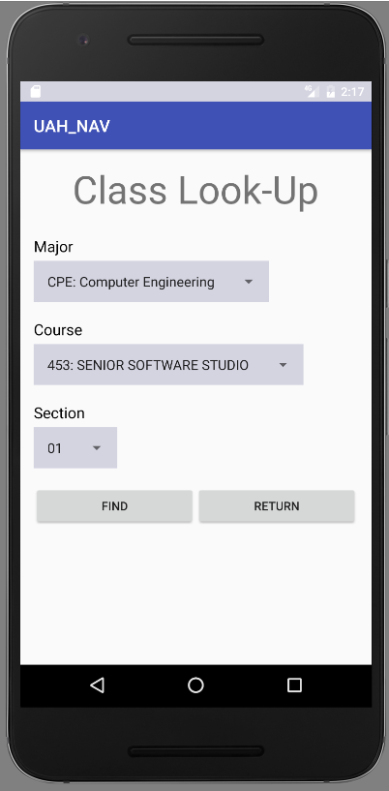
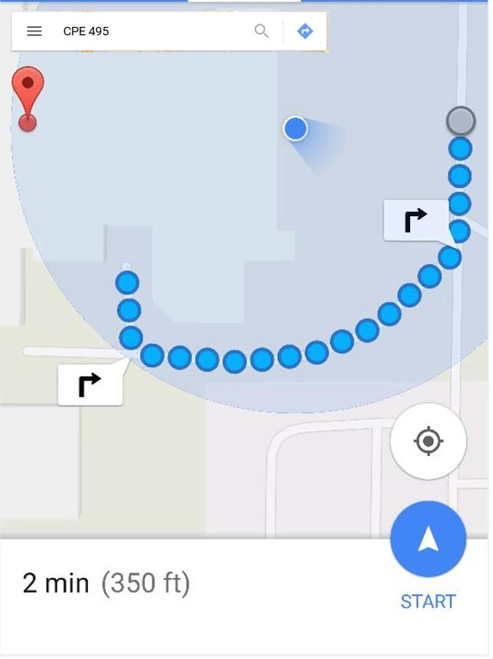
The “PokemonGo” of UAH Navigation

Slide 7
Marketing Requirements
Quick Navigation of App’s GUI. (3-Tap Design)
Customers can type in room # (EB207), Class # (CPE 495), Building ID(MSB,CU,etc.), and instantly get directions to the desired destination.
Provides Map of Campus/Maps of Buildings.
Supports GPS

Slide 8
Engineering Requirements
Implementation of GPS
Implementation of Database capable of holding large number of entries.
Easily Updatable Database Entries.
Capable of saving User Data such as class schedule, and recent locations.
Auto-completion of Search Query + interactions with drop down menus.

Slide 9
Market & Competition
No direct competition.
Other navigational apps only direct the user to the building, but do not direct users to specific rooms.
The proposed app will work at a much lower level than other Map Apps. It will also be more specific to the UAH Campus.

Slide 10
Existing Projects
There was a UAH App Project that would give the history of the buildings at UAH. It would process the building using the phones camera. Then pull up the related info. However, this App was never released and is suspected to be inactive.
UAH Events App: Targets events specific to UAH Campus Life.

Slide 11
Risk Analysis
Remote database may have stability issues. Could result in un-usable app.
GPS fails indoors.
Application can be out of date with current course listings.
Course listing page goes private.

Slide 12
Alternative Approaches
Purely Text based Navigation(MapQuest style)
Custom-Made GPS API.
Implementation of GPS chips into buildings to boost GPS signal.
AR style Over-The-Shoulder building navigation.
Indoor Maps with Google Maps instead of text-based / floor plans.
Local file system based database.

Slide 13
Proposed Approach
Interface with Google Maps to handle exterior navigation.
When GPS fails (i.e. entering a building) a text-based navigation system will enable.
Search bar will suggest auto-completion of popular and recent search terms.

Slide 14
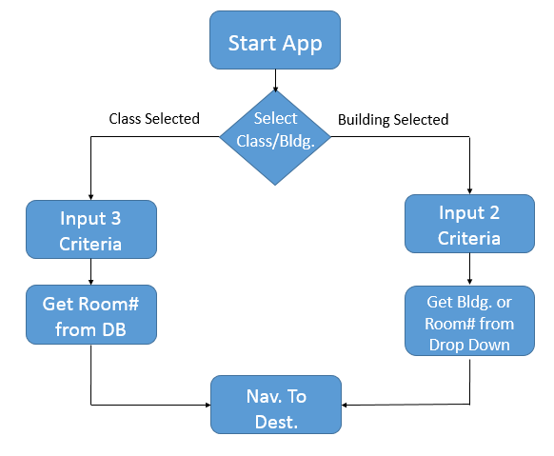
System Design Description

Slide 15
CPE 495 Go/No Go Milestone
Interface with Google Maps to lead Users to Buildings.
Pick the IDE and language that the App will be developed on.
Proof of concept that App can lead to desired classroom.
Create a Dummy App that can pull info from a database.

Slide 16
Testing Plan
Test-Driven Development Approach
Unit Tests
Updating course listings
Barebones navigation
Acceptance Tests (Emulated Testing)
Compatibility on Devices (Different android version, devices)
GPS Spoof Testing
Location testing / navigation.

Slide 17
CPE 495 Project Timeline
Deliverable objectives to complete by end of semester
–Proof of concept that the App can lead a small subset of classrooms.
–Build a dummy app that interfaces with Google Maps' API.
–Create a program that will execute on a Smartphone.

Slide 18
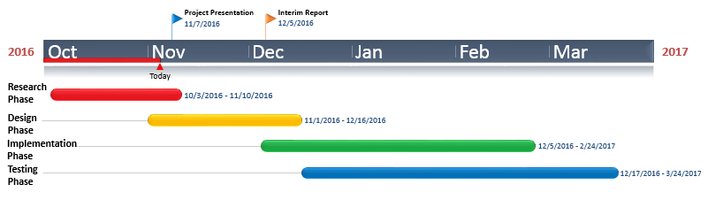
CPE 495/496 Timeline

Slide 19
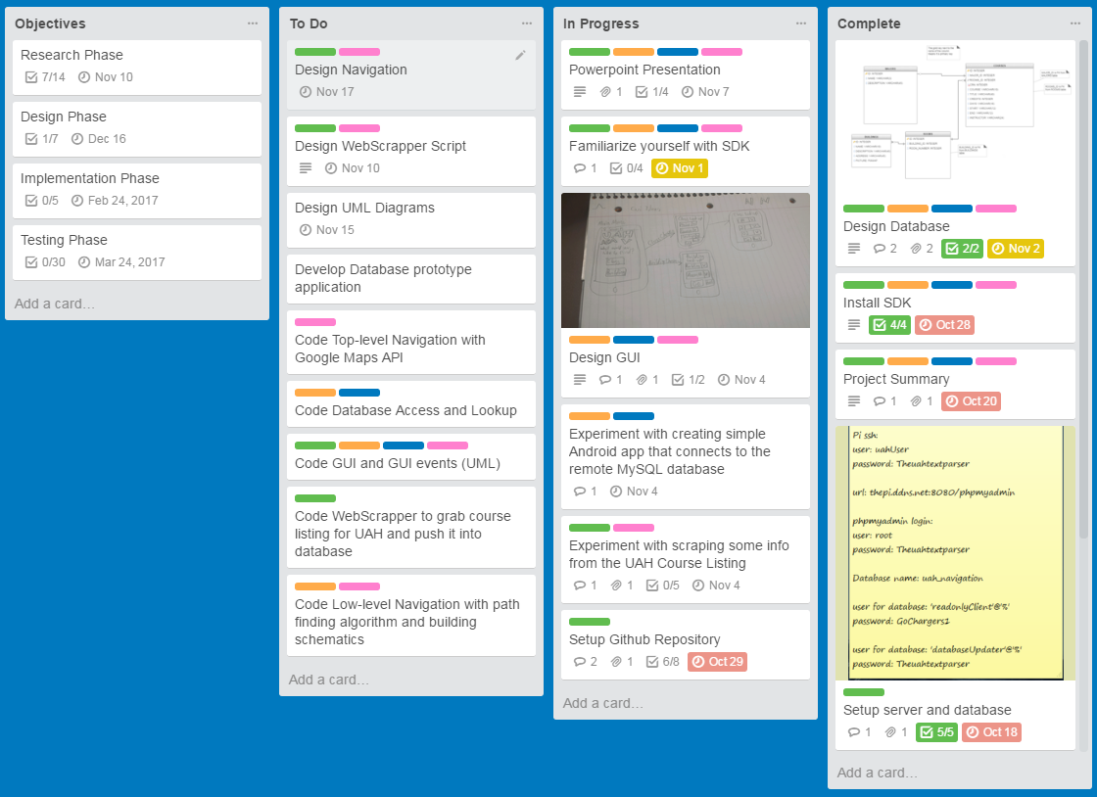
Project Timeline
https://trello.com/b/iZJ03jLi/app

Slide 20
Cost Estimation
Little to No Immediate Cost.
–Free IDE and Development Kit.
–Localized Server for Initial Roll-Out.
–Small Initial App Store fee. (Google Play, etc.)
Individual Labor Hours = 5 Hours per Week * 23 Weeks * 4 Members = 460 Hours
Meeting Hours = 2 Hours per Day * 2 Days per Week * 23 Weeks = 92 Hours

Slide 21
Current 496 Deliverables
Fully Functional Indoor UAH Navigational App for Android Devices.
Ready to Download to Most Android Devices.

Slide 22
Stretch Goals
iOS Implementation of App.
Implement GPS Chips into UAH Buildings to Boost GPS Signal to allow for Non-Text-Based Indoor Navigational Tracking.
Implement Additional Features to create more of an All-in-One UAH App, i.e. Scheduler, Forums (for information about textbooks, roommates, class info.) and interface with Events App.

Slide 23
Questions?!?1/1/1/!?!?!?
DO NOT EDIT#

